Slide 1
Anglo-Maratha Wars
SEM-IV
CC-IX
TAPASI MAITRA

Slide 2
First Anglo-Maratha War (1775–1782)
The First Anglo-Maratha War (1775–1782) was the first of three Anglo-Maratha wars fought between the British East India Company and Maratha Empire in India. The war began with the Treaty of Surat and ended with the Treaty of Salbai.

Slide 3
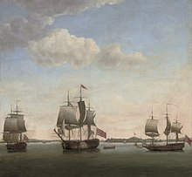
First Anglo-Maratha War
A painting depicting a British naval attack on the Maratha held Suvarnadrug fort.

Slide 4
Second Anglo-Maratha War (1803–1805
The Second Anglo-Maratha War (1803–1805) was the second conflict between the British East India Company and the Maratha Empire in India.

Slide 5
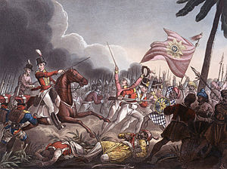
Second Anglo-Maratha War
Part of the Anglo-Maratha Wars

Slide 6
Third Anglo-Maratha War, also known as the Pindari War (1816–1818
The Third Anglo-Maratha War (1817–1818) was the final and decisive conflict between the British East India Company (EIC) and the Maratha Empire in India.
The war left the Company in control of most of India.
It began with an invasion of the Maratha territory by British East India Company troops,[the largest such British controlled force massed in India.

Slide 7
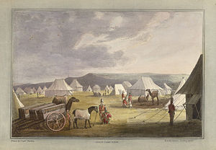
Third Anglo-Maratha War
Indian Camp Scene

Slide 8
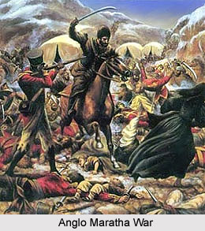
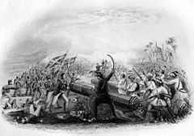

Slide 10
THANKS

